Slide 1
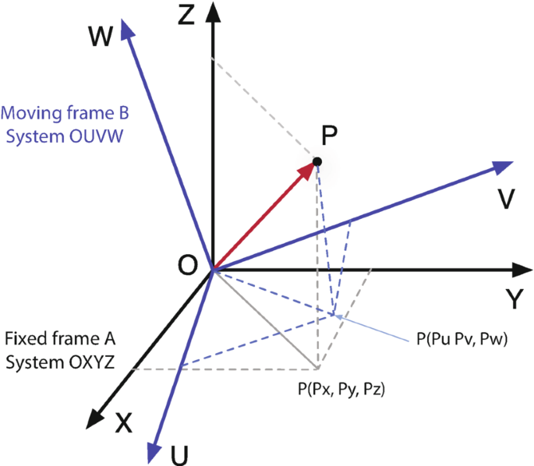
Kinematics and Dynamics
Day 01

Slide 2
Structure of End Semester Examination
Question 01 : MCQ
Question 02 : Rotation Matrices, Euler Rotation
Question 03 : VVD & AVD
Question 04 : Gears
Question 05 : Cam and Follower

Slide 3
Intermediate Frames
Section 1

Slide 4

Frames
Z
y
Fixed Frame
x
Moving Frame
o
Y
O
$$X$$
z

Slide 5


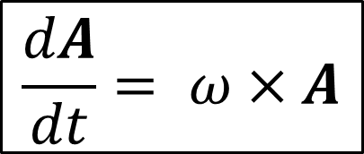
$$ω$$
y
Z
A
x
$$\frac{dA}{dt}= ω×A$$
o
Y
O
$$X$$
z

Slide 6
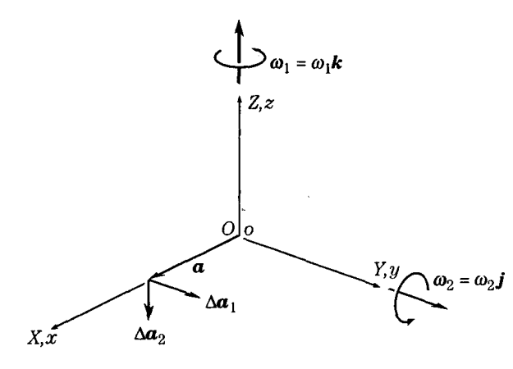
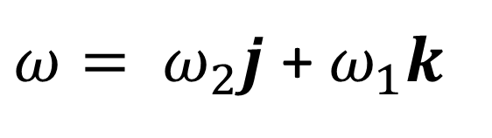
$ω= ω_{2}j$ + $ω_{1}k$

Slide 7


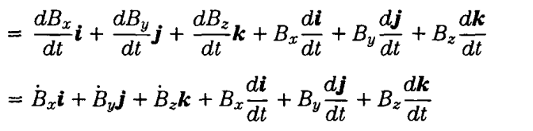



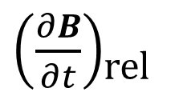
Arbitrary Vector (B)
$\left(\frac{∂B}{∂t}\right)$_{rel}
$$ω(B_{x}i+B_{y}j+B_{z}k)$$
$$ω×B$$

Slide 8
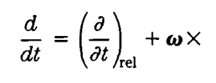
General form:

Slide 9
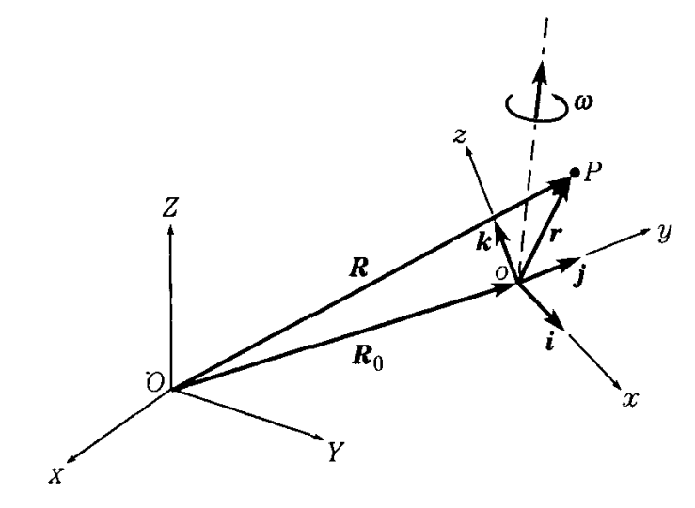
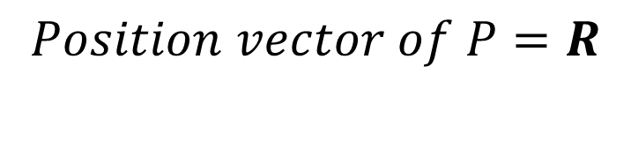
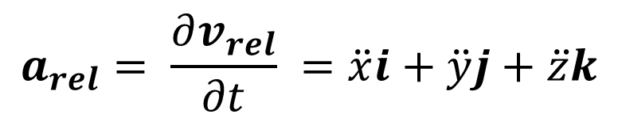
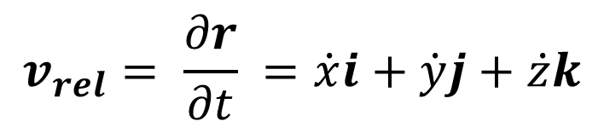

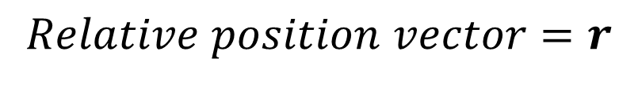
Intermediate Frames
$$Position vector of P=R$$
$$Relative position vector=r$$
$$r=xi+yj+zk$$
$$v_{rel}= \frac{∂r}{∂t} =\dot{x}i+\dot{y}j+\dot{z}k$$
$$a_{rel}= \frac{∂v_{rel}}{∂t} =\ddot{x}i+\ddot{y}j+\ddot{z}k$$

Slide 10


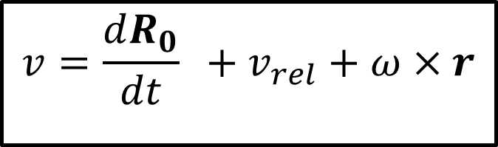

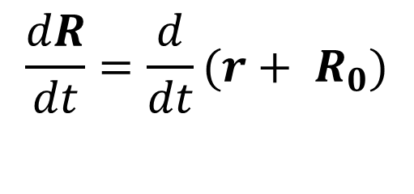
$$R=r+ R_{0}$$
$$\frac{dR}{dt}=\frac{d}{dt}(r+ R_{0})$$
$$\frac{dR}{dt}=\frac{dr}{dt}+\frac{dR_{0}}{dt}$$
$$\frac{dr}{dt}=\left(\frac{∂r}{∂t}\right)\text{rel}+ω×r$$
$$v={\frac{dR_{0}}{dt} +v}_{rel}+ω×r$$

Slide 11

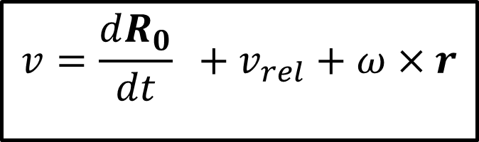
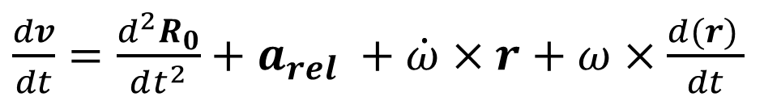
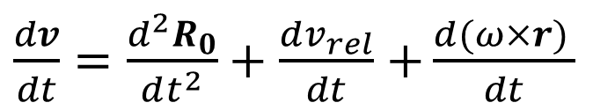
$$v={\frac{dR_{0}}{dt} +v}_{rel}+ω×r$$
$\frac{dv}{dt}=\frac{d^{2}R_{0}}{dt^{2}}+$ $\frac{dv_{rel}}{dt}$ $+\frac{d(ω×r) }{dt}$
$\frac{dv}{dt}=\frac{d^{2}R_{0}}{dt^{2}}+$ $a_{rel} +\frac{d(ω) }{dt}×r+ω×\frac{d(r) }{dt}$
$\frac{dv}{dt}=\frac{d^{2}R_{0}}{dt^{2}}+$ $a_{rel} +\dot{ω}×r+ω×\frac{d(r) }{dt}$
$$\frac{dr}{dt}=\left(\frac{∂r}{∂t}\right)\text{rel}+ω×r$$
$\frac{dv}{dt}=\frac{d^{2}R_{0}}{dt^{2}}+$ $a_{rel} +\dot{ω}×r+ω×\left[\left(\frac{∂r}{∂t}\right)\text{rel}+ω×r\right]$
$a=\frac{d^{2}R_{0}}{dt^{2}}+$ $a_{rel} +\dot{ω}×r+2ω×v_{rel}+ω×(ω×r)$

Slide 12
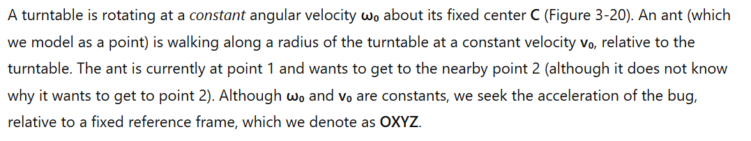
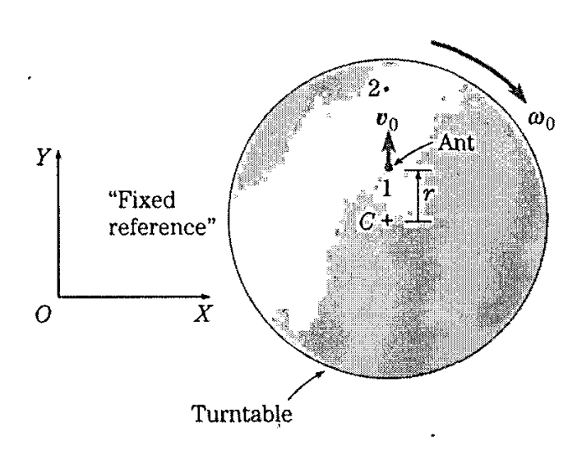
Question

Slide 13

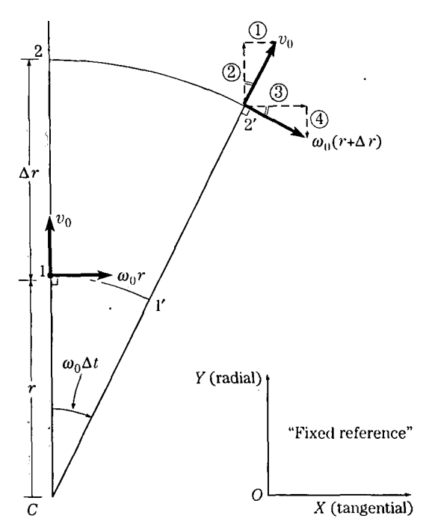
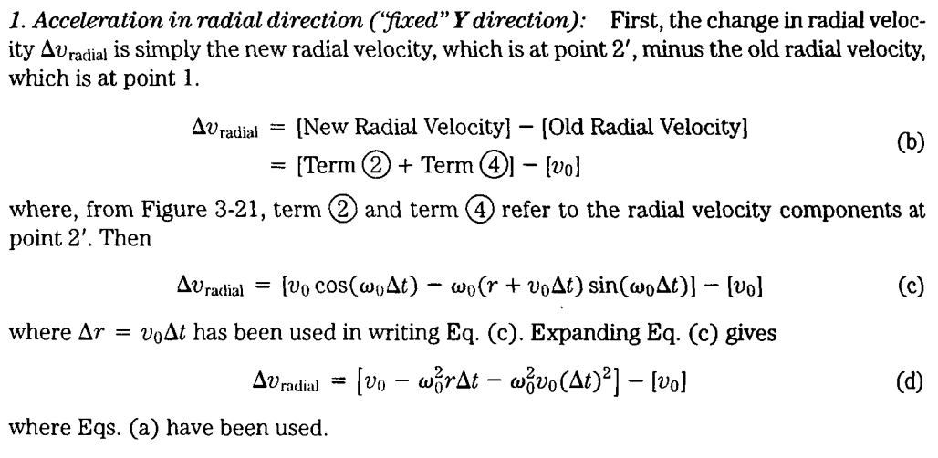
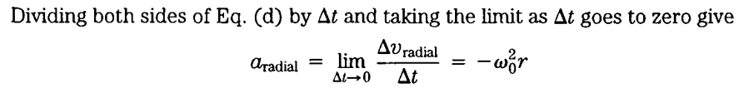
Solution

Slide 14
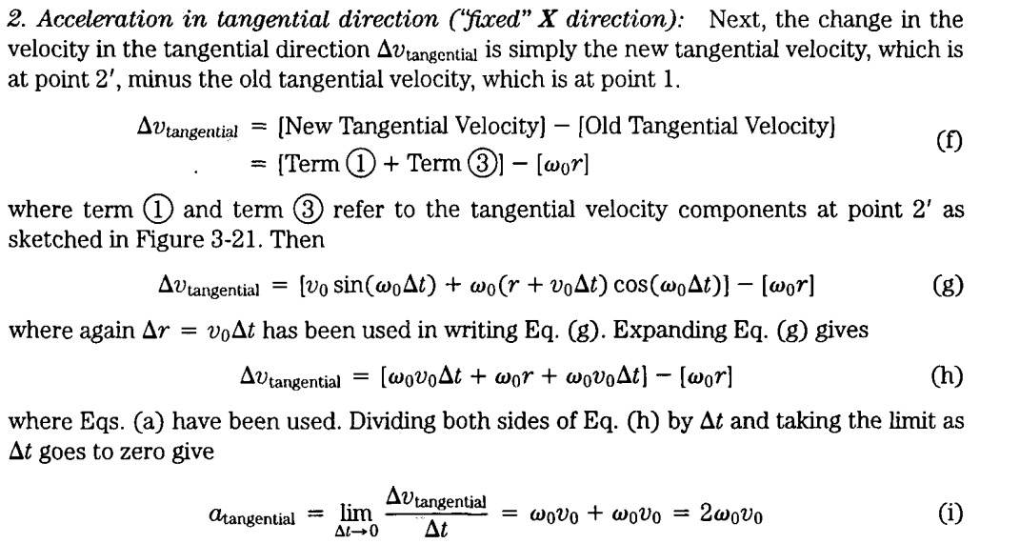

Slide 15
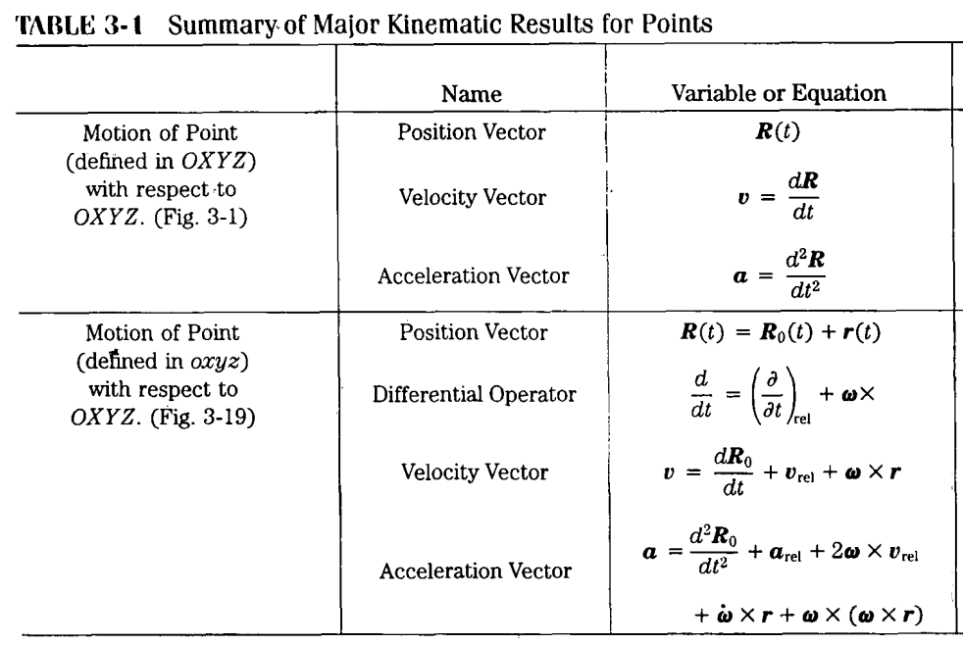

Slide 16
Generalizations of kinematic expressions
Section 2

Slide 17
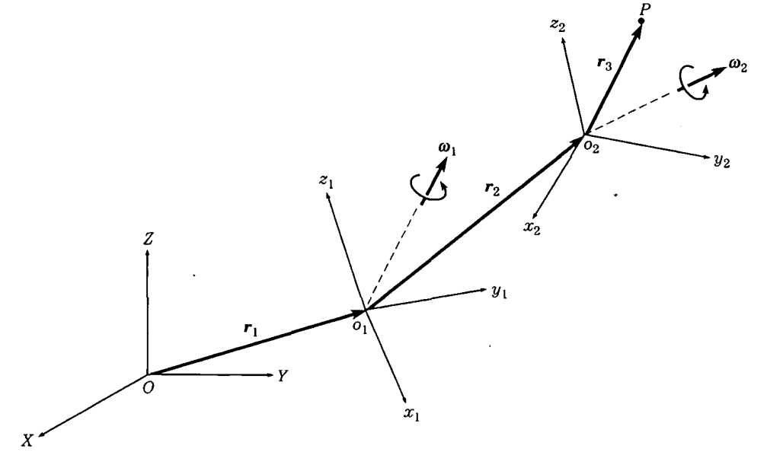



$$Frame 2$$
$$Frame 1$$
$$Frame 0$$

Slide 18



Case I
The angular motions of o₂ x₂ y₂ z₂ , $ω$₂ and $\dot{ω}$₂ are defined w.r.t. frame OXYZ.
Step 01
Neglect the Frame 2, o₂ x₂ y₂ z₂ and keep o₂ as a point.
$$O2$$
$$Frame 1$$
$$Frame 0$$

Slide 19
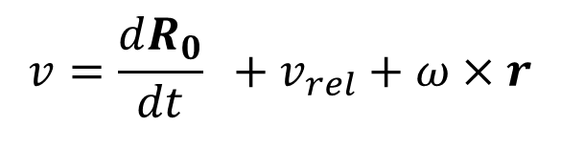
Case I
The angular motions of o₂ x₂ y₂ z₂ , $ω$₂ and $\dot{ω}$₂ are defined w.r.t. frame OXYZ.
Step 02
Write the velocity and acceleration equations for O₂ point w.r.t. Frame 0.
$$O2$$
$$v={\frac{dR_{0}}{dt} +v}_{rel}+ω×r$$
$a=\frac{d^{2}R_{0}}{dt^{2}}+$ $a_{rel} +\dot{ω}×r+2ω×v_{rel}+ω×(ω×r)$
$$Frame 1$$
$$Frame 0$$

Slide 20




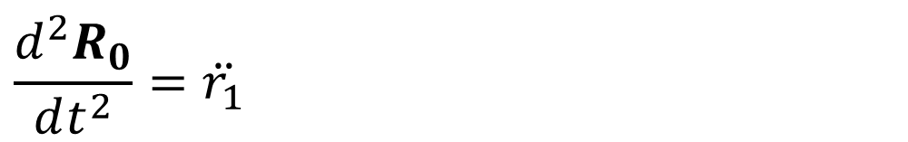
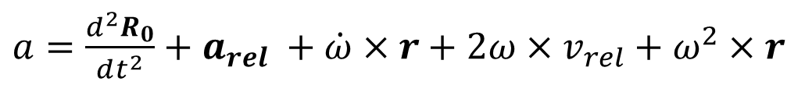

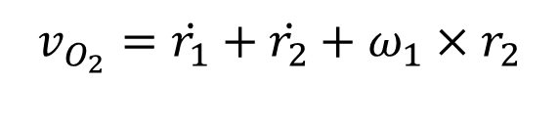
$$R_{0}= r_{1} \\ r = r_{2} \\ ω = ω_{1}$$
$$\frac{dR_{0}}{dt}\text{= }\dot{r_{1}}$$
$$\frac{d^{2}R_{0}}{dt^{2}}=\ddot{r_{1}}$$
$\dot{ω}$ = ${\dot{ω}}_{1}$
$$v_{rel}=\dot{r_{2}}$$
$$a_{rel}=\ddot{r_{2}}$$
$$v={\frac{dR_{0}}{dt} +v}_{rel}+ω×r$$
$a=\frac{d^{2}R_{0}}{dt^{2}}+$ $a_{rel} +\dot{ω}×r+2ω×v_{rel}+ω^{2}×r$
$$v_{O_{2}}=\dot{r_{1}}+\dot{r_{2}}+ω_{1}×r_{2}$$
$$a_{O_{2}}=\ddot{r_{1}}+\ddot{r_{2}}+{\dot{ω}}_{1}×r_{2}+{2ω}_{1}×\dot{r_{2}}+{ω_{1}}^{2}×r_{2}$$

Slide 21





Case I
The angular motions of o₂ x₂ y₂ z₂ , $ω$₂ and $\dot{ω}$₂ are defined w.r.t. frame OXYZ.
Step 03
Restore Frame 2 and neglect the Frame 1, o₁ x₁ y₁ z₁ and keep o₁ as a point.

Slide 22




Case I
The angular motions of o₂ x₂ y₂ z₂ , $ω$₂ and $\dot{ω}$₂ are defined w.r.t. frame OXYZ.
Step 04
As the step 02, apply velocity and acceleration equations for point P.

Slide 23


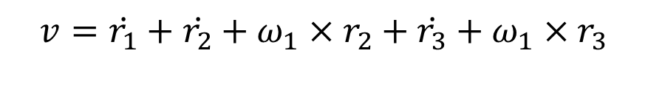


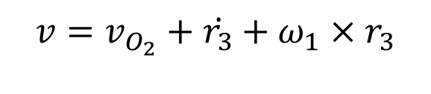
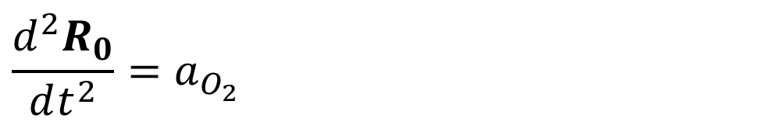

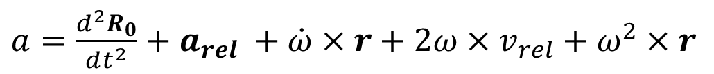
$$\frac{dR_{0}}{dt}\text{=}v_{O_{2}}$$
$$\frac{d^{2}R_{0}}{dt^{2}}=a_{O_{2}}$$
$$R_{0}= r_{1}+ r_{2} \\ r = r_{3} \\ ω = ω_{2}$$
$\dot{ω}$ = ${\dot{ω}}_{2}$
$$v_{rel}=\dot{r_{3}}$$
$$a_{rel}=\ddot{r_{3}}$$
$$v={\frac{dR_{0}}{dt} +v}_{rel}+ω×r$$
$$v=v_{O_{2}}+\dot{r_{3}}+ω_{1}×r_{3}$$
$$v=\dot{r_{1}}+\dot{r_{2}}+ω_{1}×r_{2}+\dot{r_{3}}+ω_{1}×r_{3}$$
$a=\frac{d^{2}R_{0}}{dt^{2}}+$ $a_{rel} +\dot{ω}×r+2ω×v_{rel}+ω^{2}×r$
$$a=a_{O_{2}}+\ddot{r_{3}}+{\dot{ω}}_{2}×r_{3}+{2ω}_{2}×\dot{r_{3}}+{ω_{2}}^{2}×r_{3}$$
$$a=\ddot{r_{1}}+\ddot{r_{2}}+{\dot{ω}}_{1}×r_{2}+2ω_{1}×\dot{r_{2}}+{ω_{1}}^{2}×r_{2}+\ddot{r_{3}}+{\dot{ω}}_{2}×r_{3}+2ω_{2}×\dot{r_{3}}+ω_{2}×(ω_{2}×r_{3})$$

Slide 24
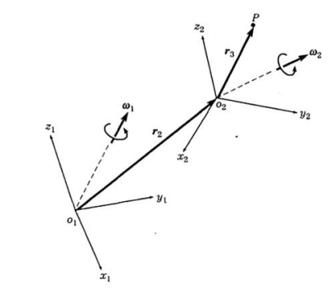
Case II
The angular motions of 𝑜₂𝑥₂𝑦₂𝑧₂, 𝜔₂ and 𝜔 ₂, are defined w.r.t frame 𝑜₁𝑥₁𝑦₁𝑧₁.
Step 01
Neglect the Frame 0, OXYZ and apply velocity and acceleration equations.

Slide 25
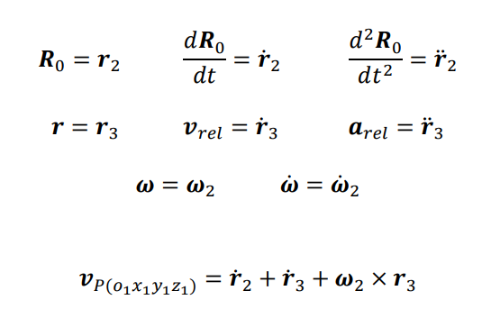

Slide 26
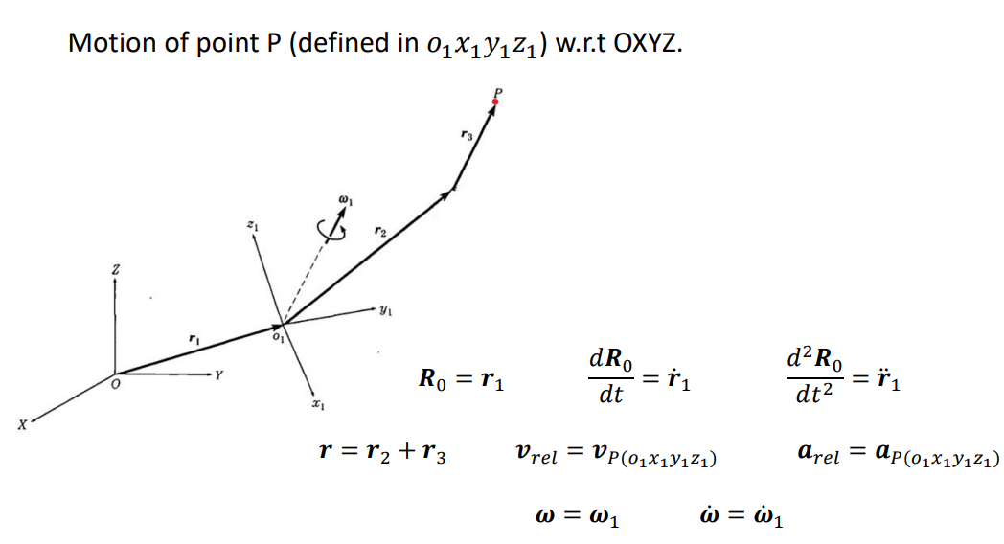

Slide 27
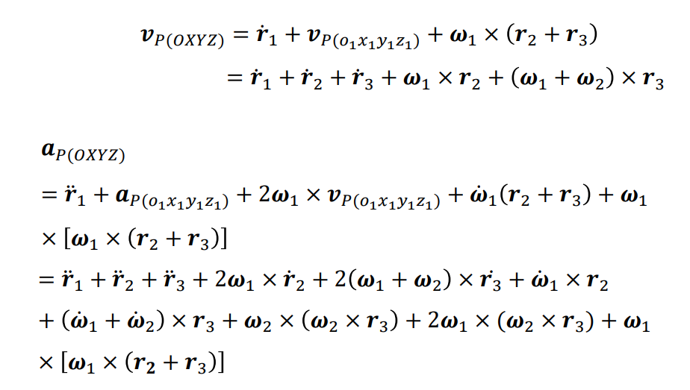

Slide 28
Questions

Slide 29
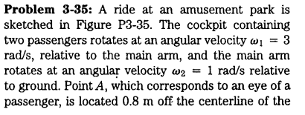
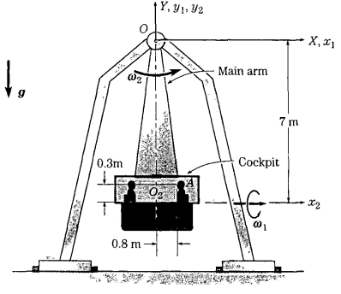
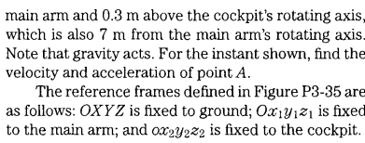

Slide 30
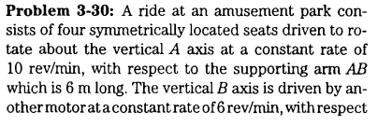
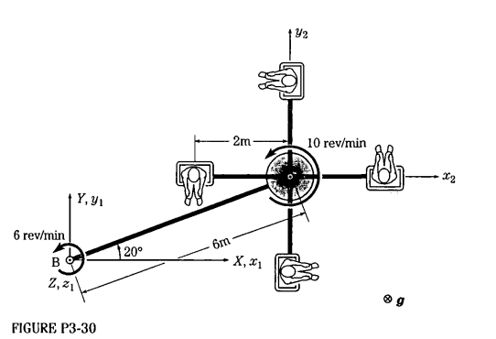
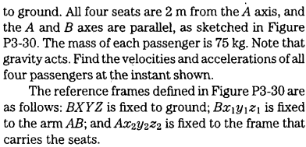

Slide 31
Momentum Analysis
Section 3

Slide 32
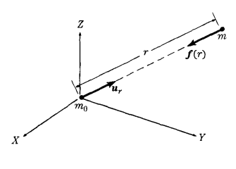
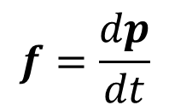

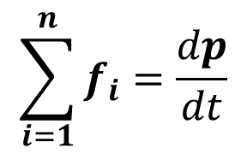
Linear Momentum and Force
$$p=mv$$
$$f=\frac{dp}{dt}$$
$$\sum_{i=1}^{n}{f_{i}}=\frac{dp}{dt}$$

Slide 33
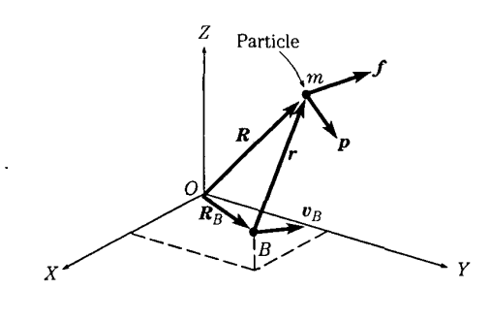





Torque and angular momentum for a particle
$r×f$ $=r×$ $\frac{dp}{dt}$
$$\frac{d(r×p)}{dt}=\frac{dr}{dt}×p+r×\frac{dp}{dt}$$
$$r \frac{dp}{dt}=\frac{dr}{dt}×p−\frac{d\left(r×p\right)}{dt}$$
$$Velocity of point B=\frac{dR_{B}}{dt}$$
$τ_{B}=r×f$
$h_{B}=r×p$

Slide 34


Question

Slide 35
Inertia Tensor
Section 4

Slide 36



For a discrete particle system
$$I_{zz}= \sum_{i=1}^{N}{\left(x^{2}+y^{2}\right)}$$
$$I_{xx}= \sum_{i=1}^{N}{\left(y^{2}+z^{2}\right)}$$
$$I_{zz}= \sum_{i=1}^{N}{\left(x^{2}+z^{2}\right)}$$

Slide 37



For a rigid body
$$I_{zz}=\int_{v}{\left(x^{2}+y^{2}\right)dv = \int_{m}{\left(x^{2}+y^{2}\right)ρdm}}$$
$$I_{xx}=\int_{v}{\left(z^{2}+y^{2}\right)dv = \int_{m}{\left(z^{2}+y^{2}\right)ρdm}}$$
$$I_{yy}=\int_{v}{\left(x^{2}+z^{2}\right)dv = \int_{m}{\left(x^{2}+z^{2}\right)ρdm}}$$

Slide 38






Slide 39


Slide 40


Slide 41

Matrix Form

Slide 42

Question

Slide 43




x
$$I_{zz}=\int_{M}{ }(x^{2}+y^{2}) dm$$
For uniform cube;
$$dm=\frac{M}{L^{3}}dx dy dz$$
Apply eqn. 1;
$$I_{zz}=\int_{−\frac{L}{2}}^{\frac{L}{2}}{ }\int_{−\frac{L}{2}}^{\frac{L}{2}}{ }\int_{−\frac{L}{2}}^{\frac{L}{2}}{ }(x^{2}+y^{2})\frac{M}{L^{3}}dx dy dz$$
Integrate wrt to x;
$$\int_{−L/2}^{L/2}{ }(x^{2}+y^{2})dx=\int_{−L/2}^{L/2}{ }x^{2}dx+\int_{−L/2}^{L/2}{ }y^{2}dx$$
$$\int_{−L/2}^{L/2}{ }(x^{2}+y^{2})dx=\frac{L^{3}}{12}+y^{2}L$$
Multiply by M/L³
$$\left(\frac{L^{3}}{12}+y^{2}L\right)\frac{M}{L^{3}}=\frac{M}{12}+\frac{My^{2}}{L^{2}}$$
$δ$y
$δ$x
y
$δ$z
z

Slide 44

Integrate with Respect to y:
$$\int_{−L/2}^{L/2}{ }\left(\frac{M}{12}+\frac{My^{2}}{L^{2}}\right)dy=\frac{M}{12}\int_{−L/2}^{L/2}{ }dy+\frac{M}{L^{2}}\int_{−L/2}^{L/2}{ }y^{2}dy$$
$$=\frac{M}{12}L+\frac{M}{L^{2}}⋅\frac{L^{3}}{12}=\frac{ML}{12}+\frac{ML}{12}=\frac{ML}{6}$$
Integrate with Respect to z:
$$\int_{−L/2}^{L/2}{ }\frac{ML}{6}dz=\frac{ML}{6}⋅L=\frac{ML^{2}}{6}$$
So;
$$I_{zz}=\frac{1}{6}ML^{2}$$

Slide 45


Parallel Axis Theorem

Slide 46



Slide 47

Product of Inertia Ext.

Slide 48

General form of inertia tensor

Slide 49


Find the moment of inertia of a structure consisting of a thin rod connecting two solid spheres about a vertical axis perpendicular to the rod and passing through its center.

